Slide 1
LifeSpan Project
Working Groups

Slide 2
Cascading Team Structure
The below figure shows how the Black Dog Institute’s LifeSpan team will be structured to support implementation
On the Ground
Those who deliver change, e.g. health staff, gatekeepers, school staff, emergency workers, etc.
Local Implementation Team (LIT)
SP Collaborative members
Central Implementation Team (CIT)
Black Dog Institute, CRESP & LifeSpan staff
Implementation experts (CEI)
Data experts (AIHW)
LifeSpan trial site representatives
Working groups

Slide 3
Work Streams
To help engage key experts, clarify planning, and manage workloads, the 9 LifeSpan strategies will be grouped into 5 work streams
Strategies grouped according to common target audiences
LifeSpan staff (at the Black Dog Institute) will be structured to align with these work streams
Key documents developed by the Black Dog Institute (e.g. outlining what each strategy will involve) will be based on these work streams

Slide 4
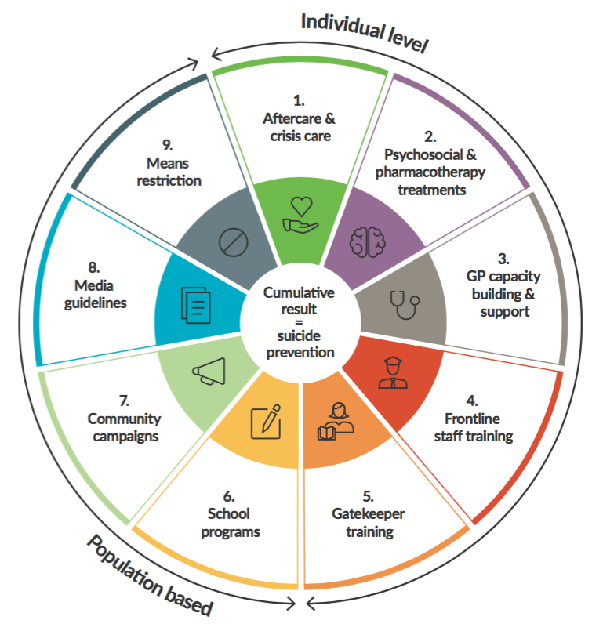
Work Streams
1: Health interventions
strategies 1, 2, 3, 4
2: Community interventions
strategies 5, 7, 8
3: School interventions
strategy 6
4: Data driven suicide prevention
suicide audit, service atlas, strategy 9
5: Indigenous suicide prevention
applies across all strategies

Slide 5
Working Groups
SP Collaborative established Working Groups aligned with these work streams
Working Groups to develop detailed and practical plans relevant to each of the relevant strategies – i.e. the Black Dog Institute will help to define what each strategy involves, the local Working Groups define the how
Each Working Group to have a ‘Lead’ who is responsible for coordinating and facilitating meetings
Working Groups may include people who do not attend the regular monthly meeting, but have specific skills relevant to the Working Group
We are wanting people with lived experience of suicide to be involved in each of the Working Groups. They will be supported to ensure their involvement is a positive experience.
Those contributing to the Working Groups outside of their paid employment role will be paid for their participation.
SP Collaborative staff to attend all Working Group meetings to ensure plans complement each other

Slide 6
Working Groups
Work Stream | Working Group Members
1: Health interventions | Linda Livingstone (COORDINARE) * Adam McRae (GPH) Lynn Langhorn (ISLHD) Judith Simons (One Door MH) Yvonne McKenna (Hearing Voices Network) John Turner (ISPIR, LE) Helen Backhouse (Flourish) Tim Heffernan (ISLHD, LE) Lyndall Fowler (West Street) | Kylie Hanigan (LE) Grahame Gould (Lifeline) Julie Carter (ISLHD) Lorna Moxham (UOW) Ann Frankham (LE) Susan McMurdo (LE) Police Ambulance
2: Community interventions | Carrie Lumby (Hearing Voices Network) * Clare Leslie (Lifeline) * Armando Reviglio (WCC) Emily Delovska (LE) Gordon Bradbery (WCC) Kelly Parish (ARAFMI) Eleanor Ashford (LE) John Casey (ACON) Toni Garretty (ISLHD) | Linda Livingstone (COORDINARE) Clemantina Velasco (headspace Wollongong) Kristine Laird (COORDINARE) Nick Guggisberg (Kiama Council) Tim Heffernan (ISLHD, LE) Sandra Bolack (ISPAN) Susan McMurdo (LE) SSPAN
3: School interventions | Eleanor Ashford (LE) * Tim Heffernan (ISLHD, LE) * Heather McCarron (TAFE) Yvonne McKenna (Hearing Voices Network) Emily Delovska (LE) Roz Jennings (Department of Education) | Kathryn Baudinette (headspace) Leanne Woodley (AIS) Kylie Hanigan (LE) Lynne Harris (Department of Education) Cynthia McCammon (Catholic Education)
4: Data driven suicide prevention | Grahame Gould (Lifeline) * Linda Livingstone (COORDINARE) Debra Murphy (RDA Illawarra) Wollongong City Council | Shoalhaven Council Shellharbour City Council Kiama Council
5: Aboriginal suicide prevention | Glenn Williams (MIND the GaP) Helen Backhouse (Flourish) Tim Heffernan (ISLHD, LE) Clare Lesley (Lifeline) | Ann Frankham (LE) Michelle Dickson (Waminda) South Coast AMS Illawarra AMS
* Working Group Lead

Slide 7
Feedback loop
WGs will keep records of meetings in the form of key action items & discussion points (no need for full minutes)
These will be posted on the Collaborative’s website
WG Leads will feedback to the monthly SP Collaborative meeting
Membership updates
Current focus of WG discussions
Requests for input from broader Collaborative
Anticipated challenges of note
Recommendations for general Communications Strategy
Documented plans can also be shared with broader Collaborative for review (at certain landmarks)

